Slide 1

AWS Solution Architect Course-End Project
Ashutosh Srivastava
12ashu12@gmail.COM
www.linkedin.com/in/ashutosh-srivastava-12ashu12

Slide 2
Problem Statement and Motivation Content
Real-World Scenario:
TELEMAX is a company expanding its network into underserved markets globally.
They provide innovative communications hardware for efficient networking links.
Need:
Deploy an effective NoSQL-based data warehousing architecture.
Handle real-time data for future analysis to optimize network topologies.
Solution Approach:
Utilize AWS cloud services to build a real-time data management system.

Slide 3

Summary of Steps
Step 1: Create AWS Kinesis Data Stream
Setup Kinesis stream to handle incoming data.
Step 2: Create AWS Lambda Function for Data Ingestion
Develop Lambda function to pull data from a URL and stream it to Kinesis.
Step 3: Add Python Layer to Lambda Function
Include necessary libraries like requests in a Lambda layer.
Step 4: Deploy and Verify Kinesis Data Stream
Check if data is streaming correctly using Kinesis Data Viewer.
Step 5: Create Lambda Function for Data Loading
Develop Lambda function to read from Kinesis and write to DynamoDB.
Step 6: Configure Permissions for Lambda Functions
Assign appropriate roles and permissions to Lambda functions.
Step 7: Monitor CloudWatch Logs
Review logs to ensure Lambda functions are running correctly and debug issues.
Step 8: Verify Data in DynamoDB
Check DynamoDB to confirm data is loaded and accessible.

Slide 4
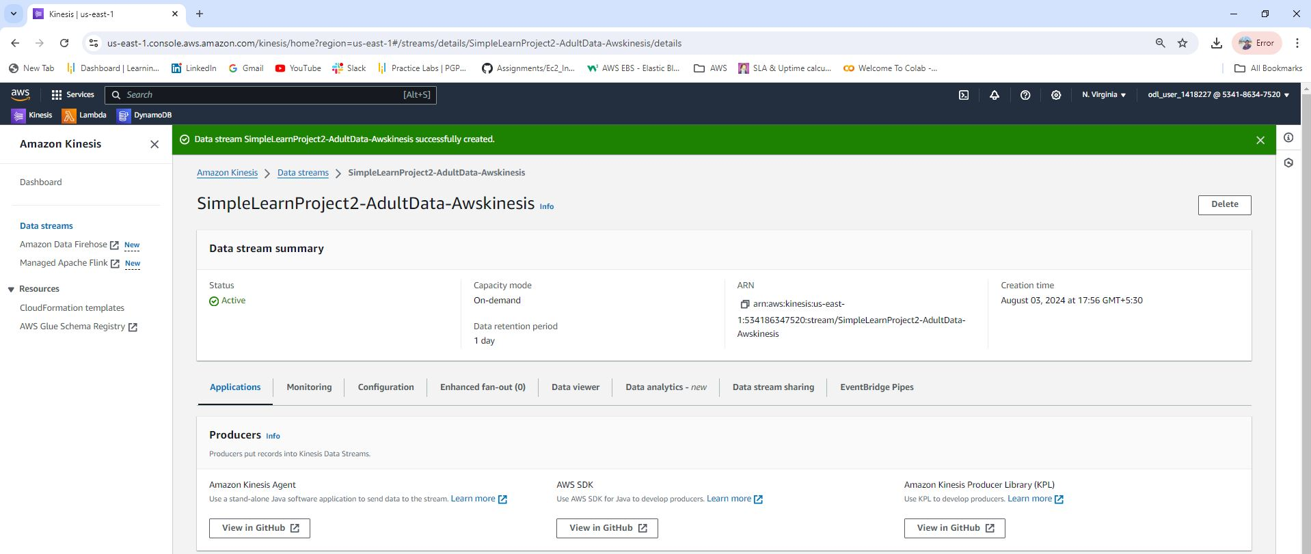
Step 1 : Aws Kinesis Data Stream Creation
Created AWS Kinesis Data Stream named: SimpleLearnProject2-AdultData-Awskinesis
Screenshot: [Include screenshot of Kinesis Data Stream creation]

Slide 5
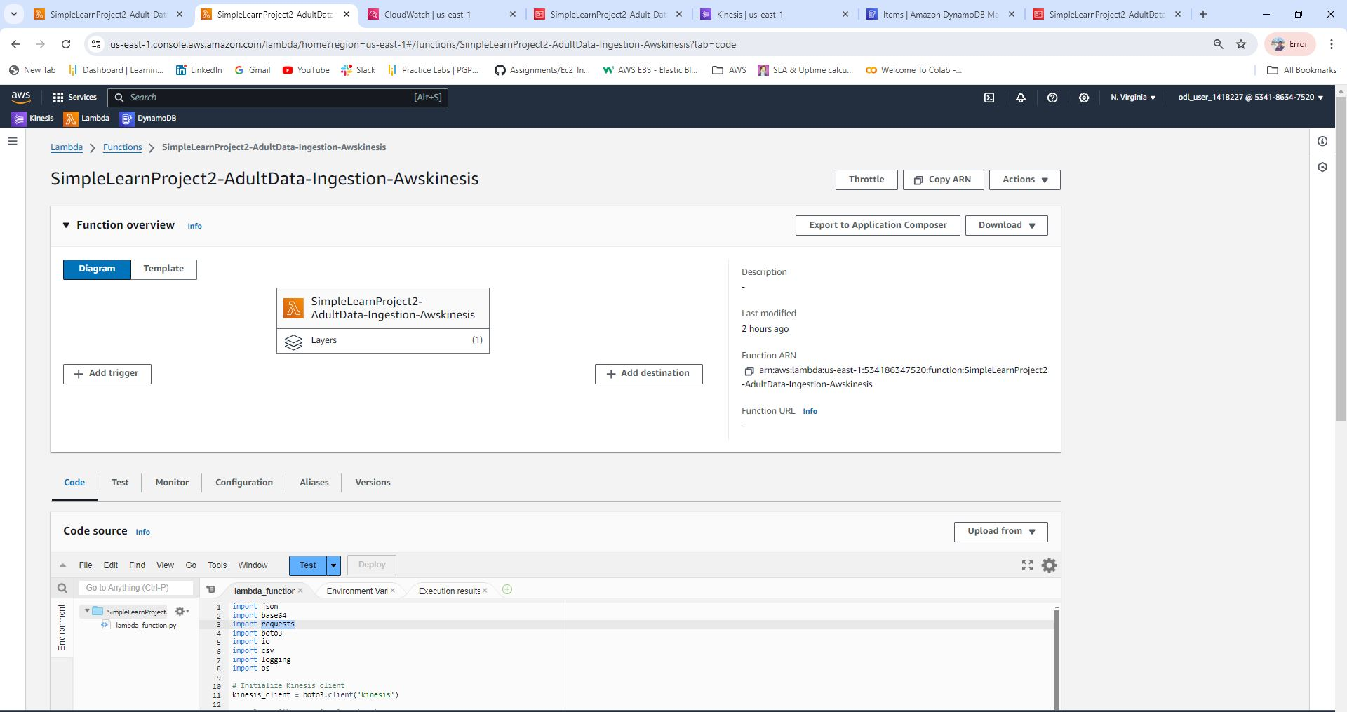
Step 2: Create Python Code on AWS Lambda Function
Lambda function to ingest data from URL:
https://archive.ics.uci.edu/ml/machine-learningdatabases/adult/adult.data
Details:
Function processes data and streams it to Kinesis
Screenshot: [Include screenshot of Lambda function code]

Slide 6
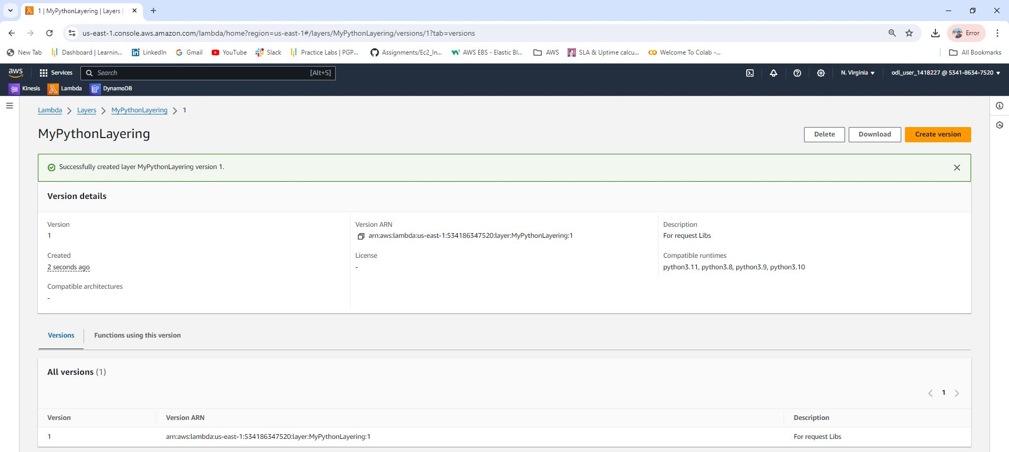
Step 3: AWS Lambda Function with Python Layer
Lambda function name: SimpleLearnProject2-AdultData-Ingestion-Awskinesis
Added Python layer for requests library (not available by default)
Screenshots:

Slide 7
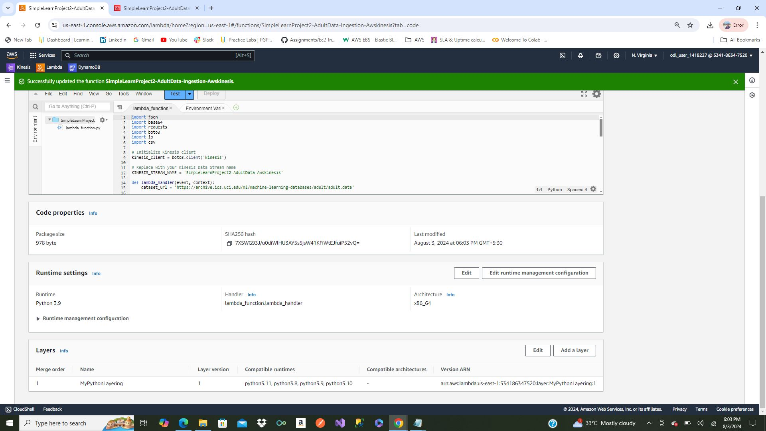
Step 3: AWS Lambda Function with Python Layer Continue
Layer added to Lambda Function
Screenshots:

Slide 8
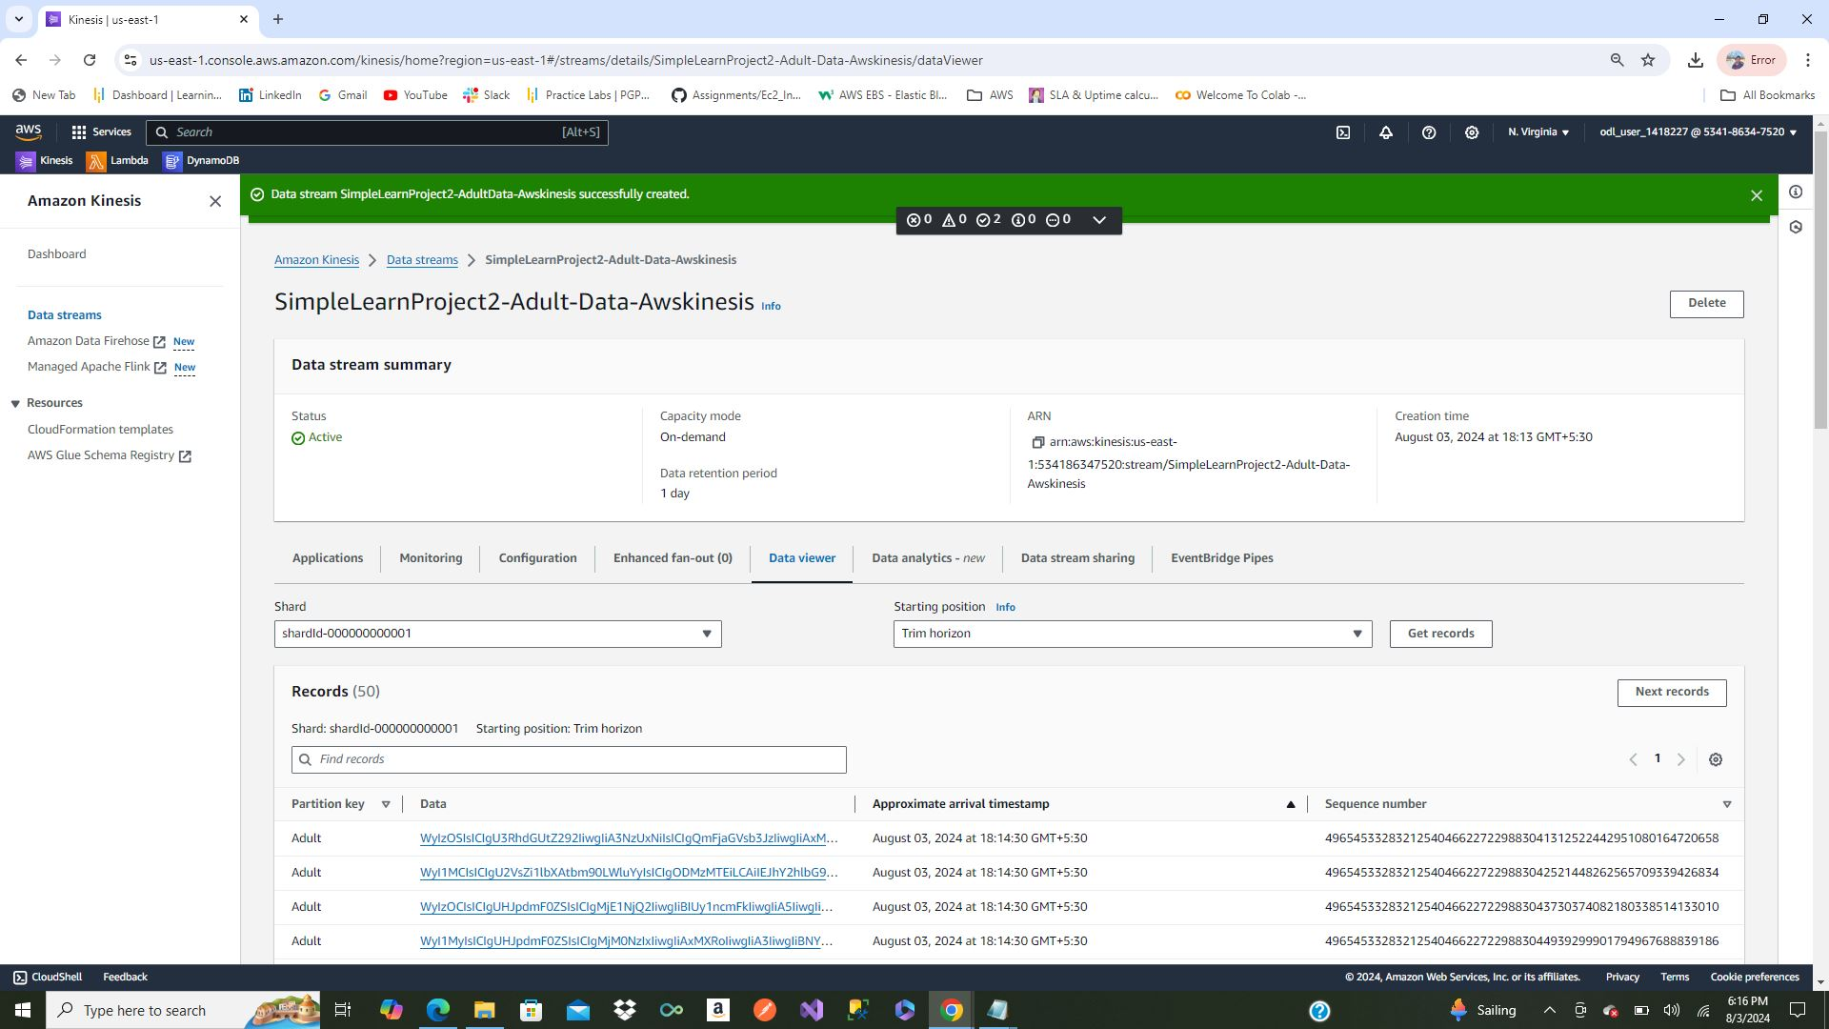
Step 4: Deploy & Verify Kinesis Data Stream
Deployed Lambda function and verified data streaming using Kinesis Data Viewer

Slide 9
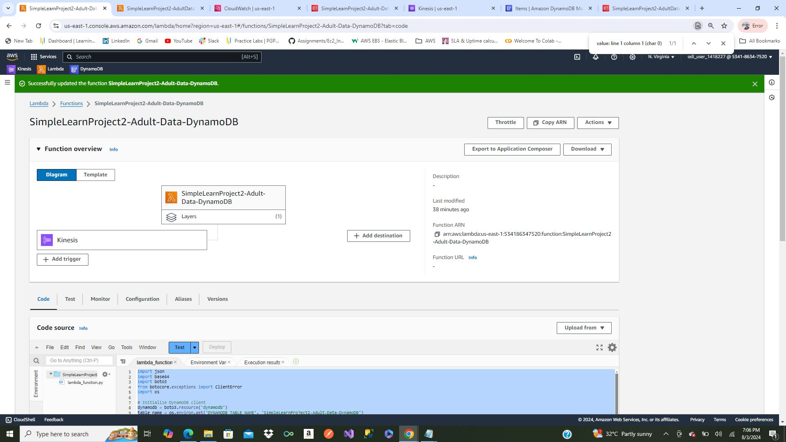
Step 5: AWS Lambda Function for Data Loading
Created Lambda function to read from Kinesis and load data into DynamoDB Lambda function name: SimpleLearnProject2-Adult-Data-DynamoDB-LambdaFunction

Slide 10
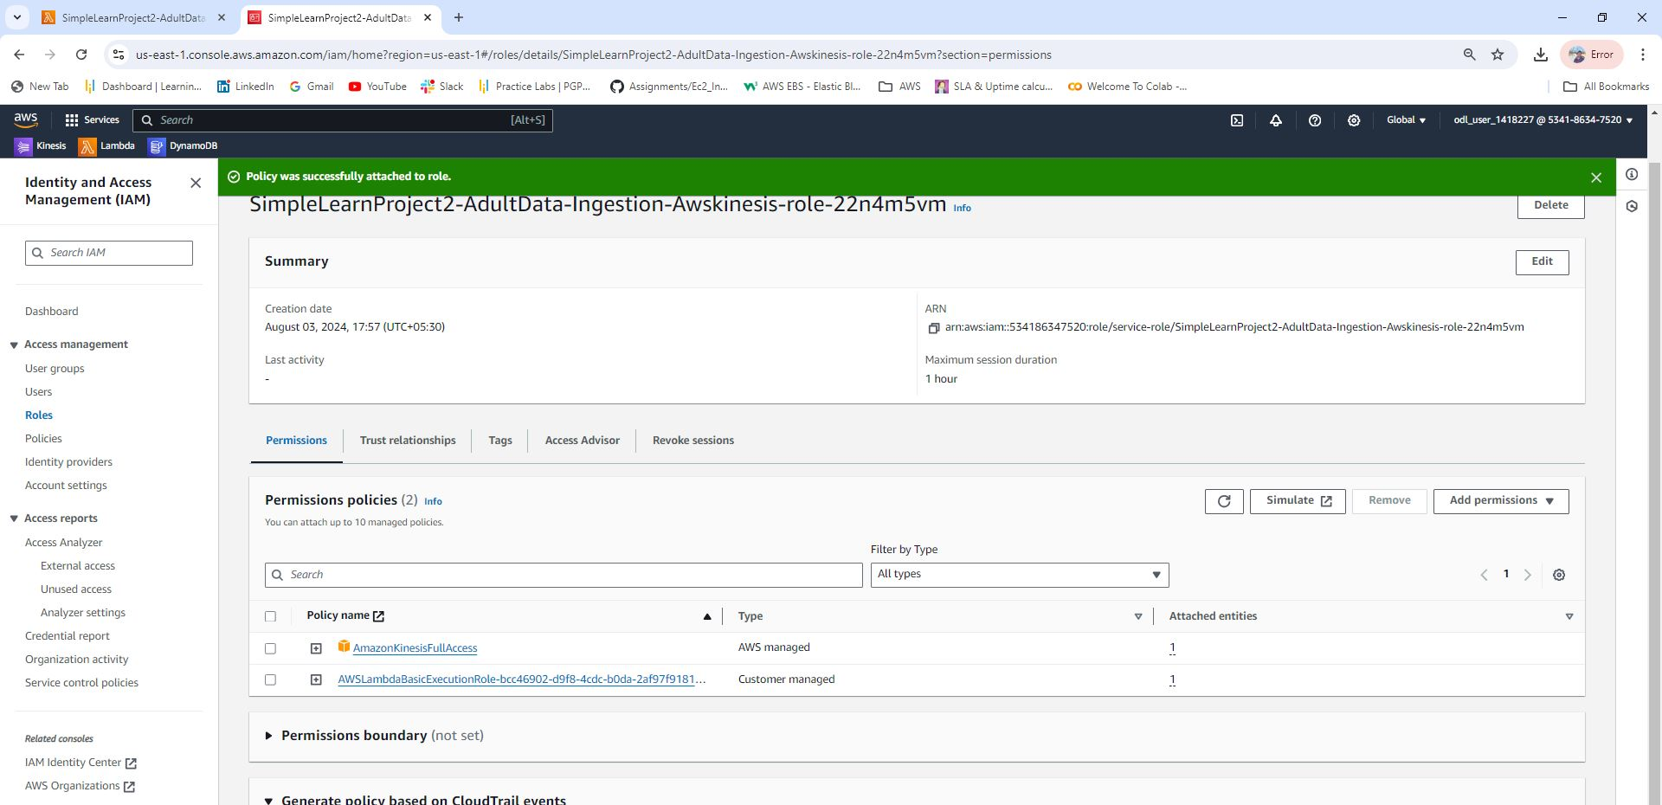
Step 6: Add Permissions to Lambda Functions
Assigned necessary permissions for both Lambda functions, Below for Ingestion AWS Kinesis

Slide 11
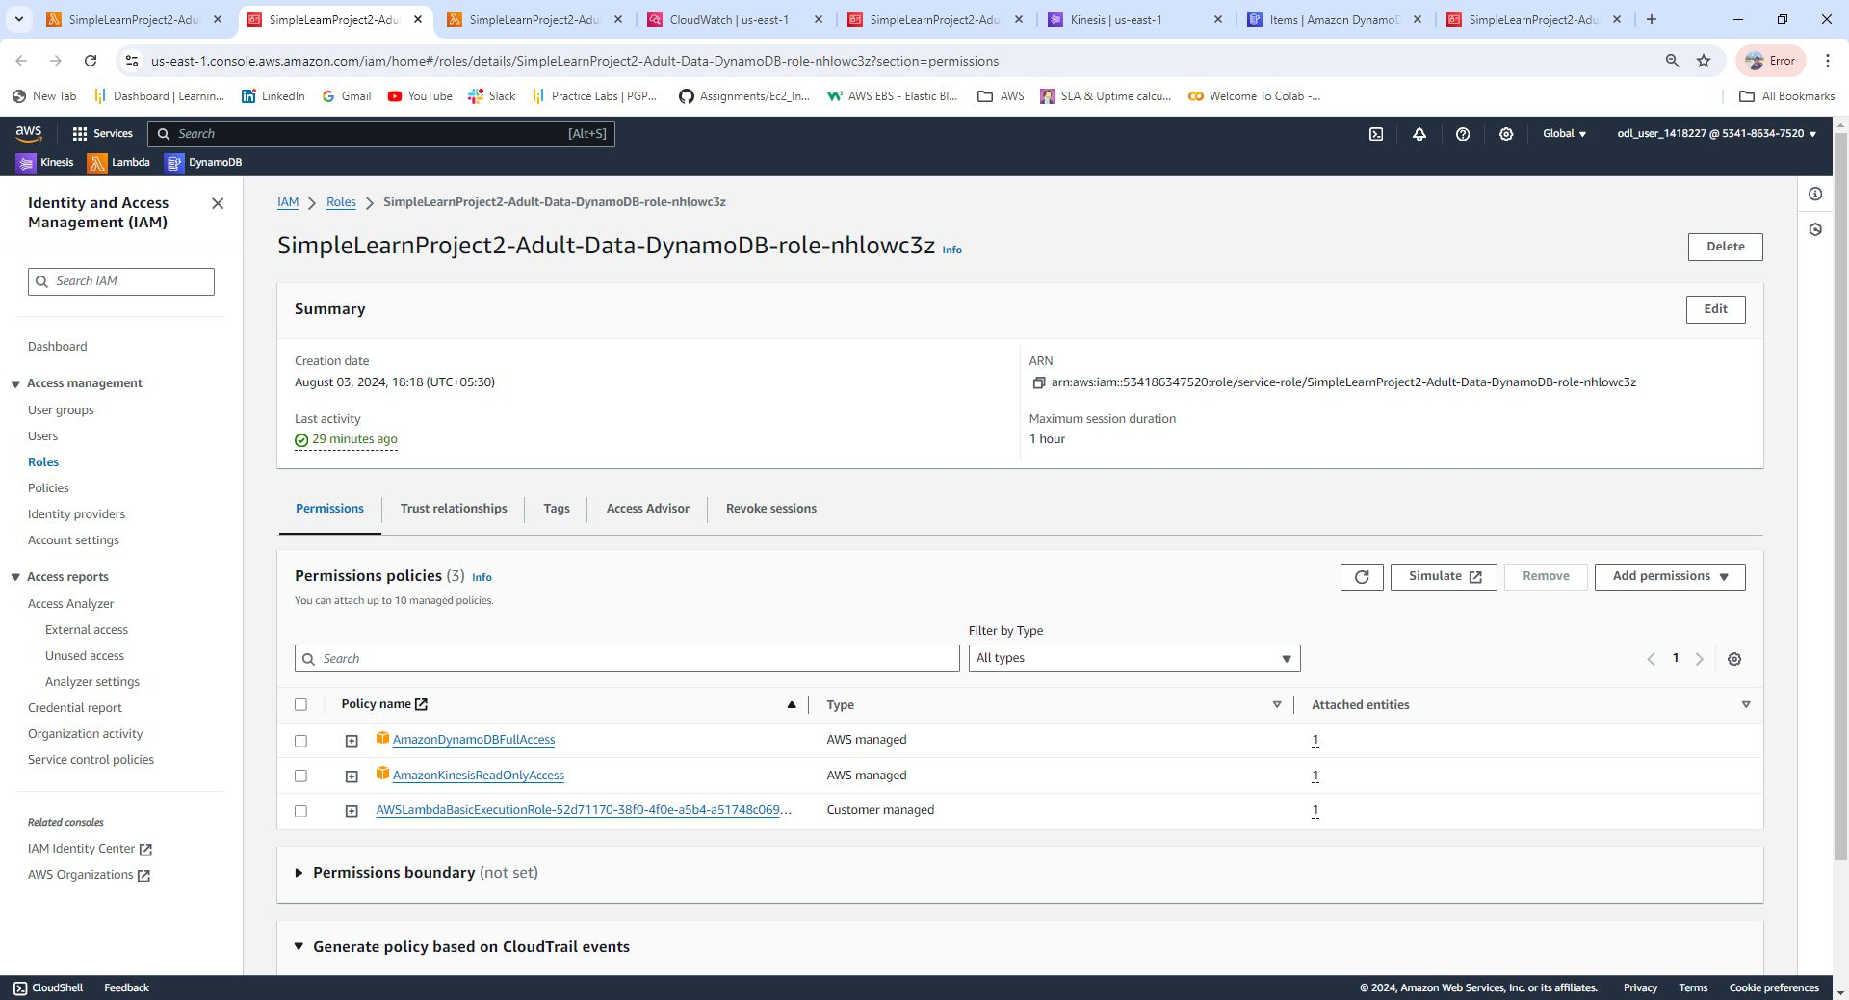
Step 6: Add Permissions to Lambda Functions
Assigned necessary permissions for both Lambda functions, Below for Ingestion AWS DynamoDB

Slide 12
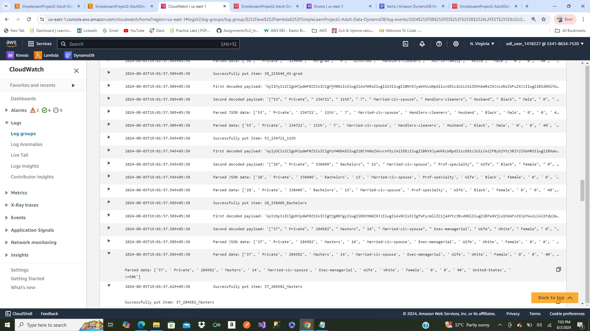
Step 7: Check AWS CloudWatch Logs
Monitored CloudWatch logs for SimpleLearnProject2-Adult-Data-DynamoDB-LambdaFunction to identify and debug errors

Slide 13
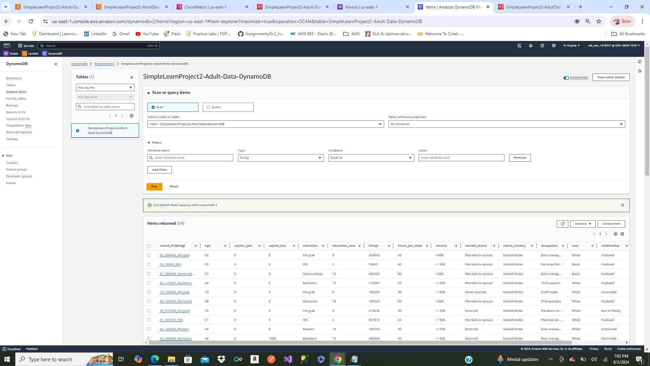
Step 8: Verify Data in DynamoDB Table
Verified data was successfully loaded into DynamoDB table SimpleLearnProject2-Adult-Data-DynamoDB

Slide 14
Conclusion
Successfully deployed a real-time data management solution on AWS.
Achievements:
Streamed data using AWS Kinesis
Processed and loaded data into DynamoDB using Lambda functions Verified data flow and integrity

Slide 15


Thank You
12ashu12@gmail.COM
www.linkedin.com/in/ashutosh-srivastava-12ashu12

